Slide 1
TrafficPlanner
A Gamified Traffic Management Simulation
A dissertation for the Degree of
Bachelor of Engineering (Computer Engineering)
National University of Singapore
18 April 2018

Slide 2
Introduction
Backgrounds and Objective of TrafficPlanner

Slide 3
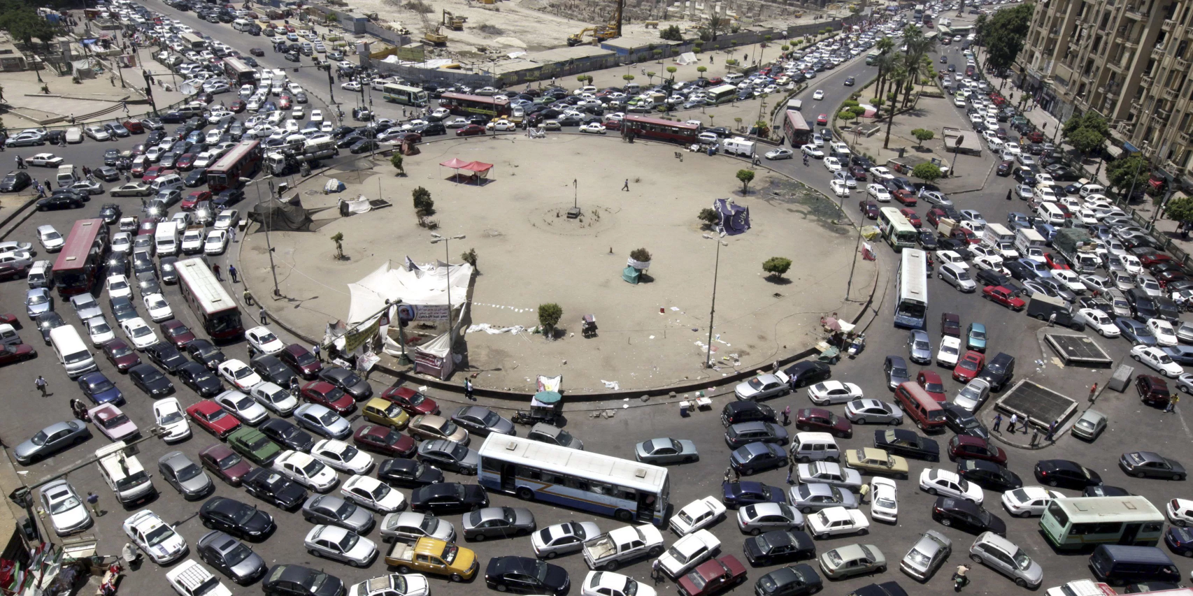
Some Backgrounds
General public as primary stakeholder in traffic planning.
Limited venues of public participation in traffic planning.
Swedish authorities' public dialogues and interviews in traffic planning (Wahl, 2013).
Theory-practice gap in the designed road networks.
Figure 1. Gridlock at a roundabout in Africa^{[1]}
[1] “African Countries Still Can't Raise Enough Capital to Fix Their Road Networks,” by Abdi Latif Dahir, 2017. Retrieved from https://qz.com/945724/african-countries-still-cant-raise-enough-capital-to-fix-their-poor-road-networks/

Slide 4
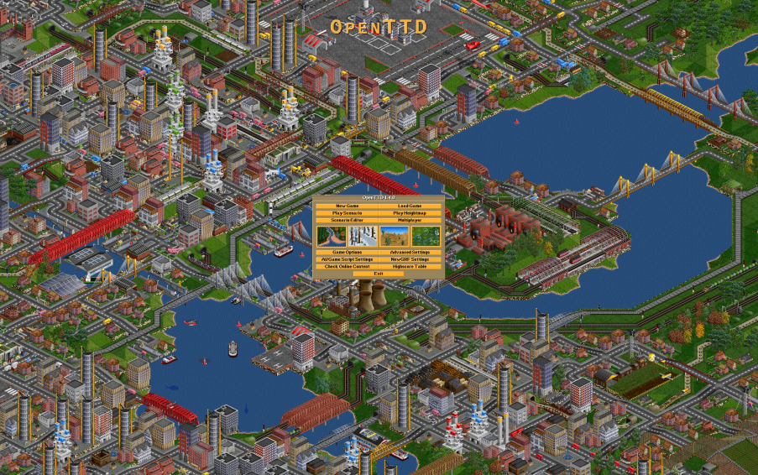
Some Backgrounds
Traffic simulation has become an integral part in traffic planning process (Rioux, 2015).
Ability to quickly analyze detailed outcomes of multiple traffic scenarios.
Well reception of traffic management games.
OpenTTD (2004). Open-source rendition of Transport Tycoon (1995).
Figure 2. OpenTTD in-game screenshot^{[2]}
[2] “OpenTTD,” by OpenTTD Team, 2015. Retrieved from https://www.openttd.org/en/about

Slide 5
Objective
To develop a gamified platform that allows direct participation of general public in traffic planning.
By designing efficient road networks on given traffic scenarios measurable through traffic simulation.

Slide 6
Approaches Taken
Requirements, Designs and Implementations

Slide 7
Key Requirements
Ability to design traffic scenarios.
Ability to design road networks to solve traffic scenarios.
Ability to browse other users' designs.
Ability to simulate the road networks.
Ability to compare a design with another in terms of efficiency.

Slide 8
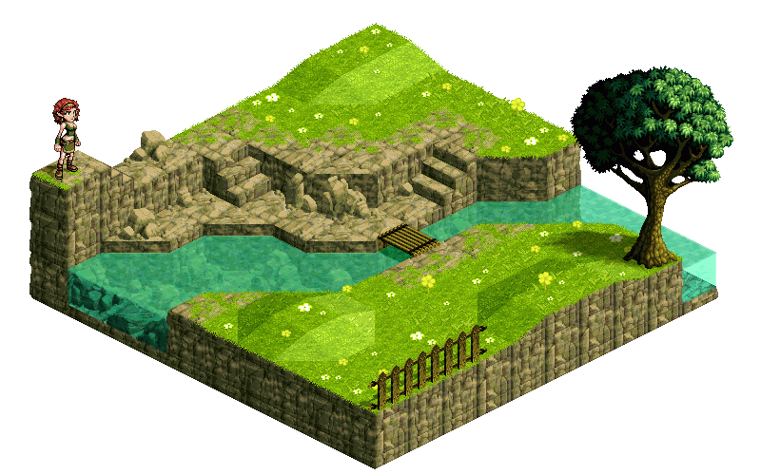
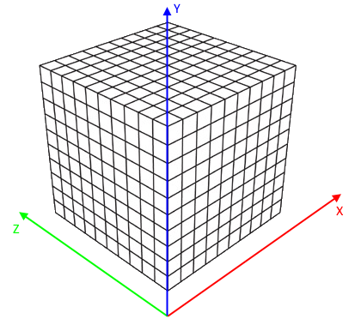
Design Decisions Grid-based System
Representation of the whole play area in grids.
Allows better rendering performance (Antochi, Juurlink, Vassiliadis and Liuha, 2004).
Allows for discretization of coordinates for reproducibility purposes.
Figure 3. Example of grid-based game
Figure 4. Visualization of grid-based system

Slide 9
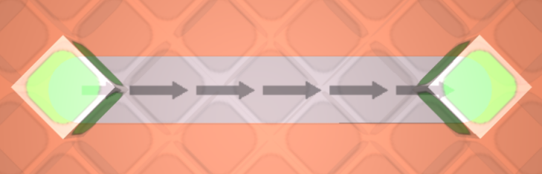
Design Decisions Grid-based Representation of Structures
Structures such as roads and buildings need to adhere to the grid-based system.
Uniquely representable by the 2 bounding grids:
Grid with lowest (x, y, z) coordinates
Grid with highest (x, y, z) coordinates
Figure 5. Bounding grids of a road

Slide 10
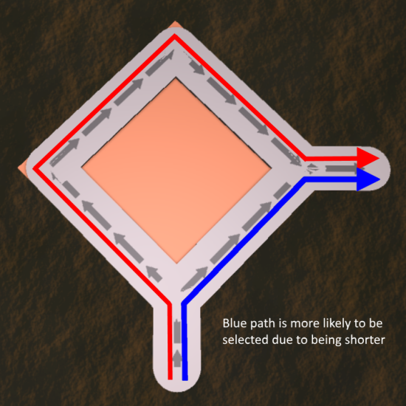
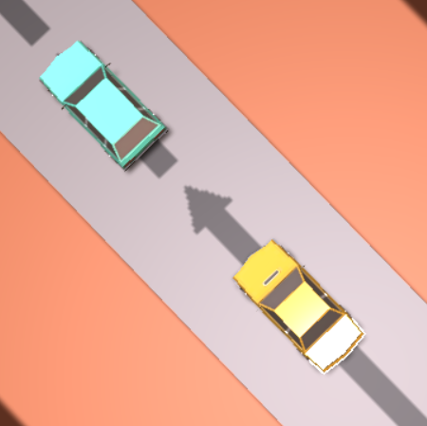
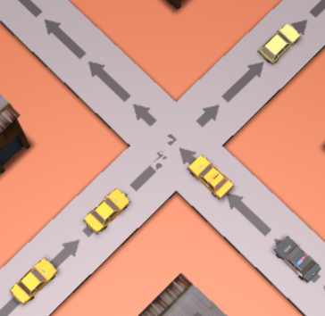
Design Decisions Autonomous Vehicle Behaviors
Simulated vehicles should be able to:
Follow a valid path from source to destination.
Higher chance of following a shorter path.
Emulate queuing behavior.
Keeping a safe frontal distance.
Giving way on intersections if needed.
Figure 6. Selection of path based on distance
Figure 7. Vehicle queueing behaviors

Slide 11
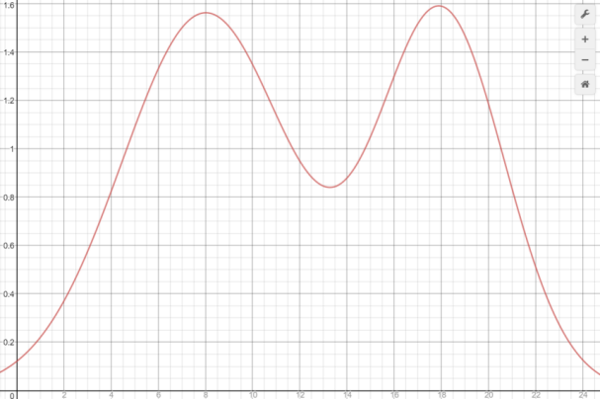
Design Decisions Traffic Volume Distribution
Simulated traffic needs to closely follow the real-world traffic distribution.
Fluctuates with respect to time of day.
Is a bimodal function in the form of
Figure 8. Traffic volume distribution in TrafficPlanner

Slide 12
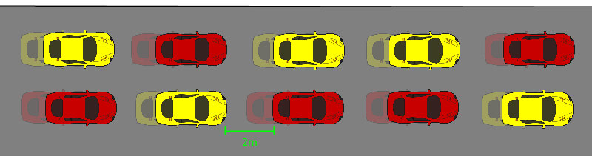

Design Decisions Design Efficiency Measure
Traffic flow is expressible in many measures (Kovačić, Ivanjko, Jelušić and Gold, 2015).
Average traffic velocity is invariant to road lengths and congestion severeness.
Figure 10. Design efficiency measure formula
Figure 9. Creeping and halting congestion

Slide 13
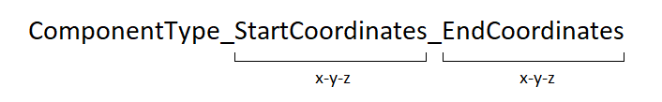
Design Decisions Serialization of Design into Metadata
For design reproducibility and sharing purposes.
The metadata should be able to sufficiently describe:
What game component it is (roads, buildings, traffics, etc.).
Where is this component positioned.
How is this component oriented.
Example:
Road starting at (1, 1, 1) and ending at (3, 1, 3).
rd_1-1-1_3-1-3
Landmark starting at (1, 1, 1) and ending at (5, 5, 5)
lm_1-1-1_5-5-5
Figure 11. Component metadata format

Slide 14
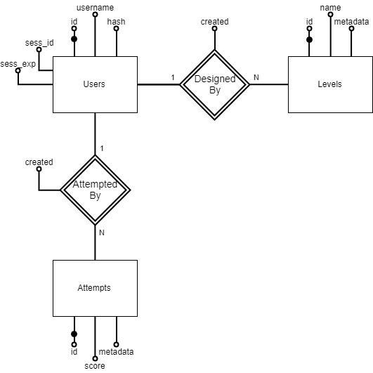
Design Decisions Remote Database Design
Entity sets:
Users
Levels
Attempts
Relationship sets:
Designed by: Users -> Levels
Attempted by: Users -> Attempts
Figure 12. Remote database ER diagram

Slide 15
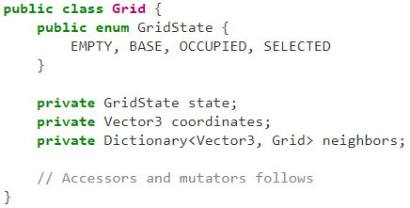
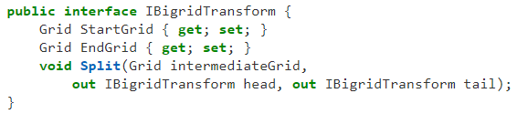
Implementations Grid-based System
A grid needs to keep track of its:
State: mainly if it is empty or occupied
Coordinates: as a unique identifier
Neighbors: reference to neighboring grids for access purposes
These grids will also be used to represent the position and orientation of in-game structures.
Done through the IBigridTransform interface, implemented by all structures.
Figure 14. C# snippet of IBigridTransform interface
Figure 13. C# snippet of Grid class

Slide 16
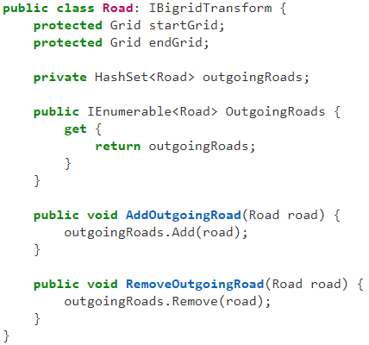
Implementations Interconnection Between Roads
Each road keeps track of the outgoing roads.
Outgoing road is defined as a road whose start grid is equal this road's end grid.
This forms a directed graph used for path-finding purposes.
Figure 15. C# snippet of Road class

Slide 17
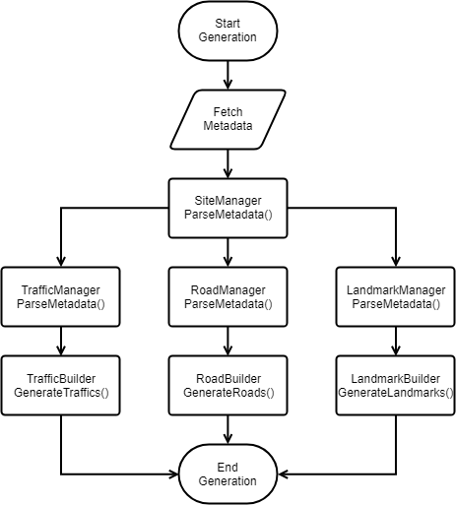
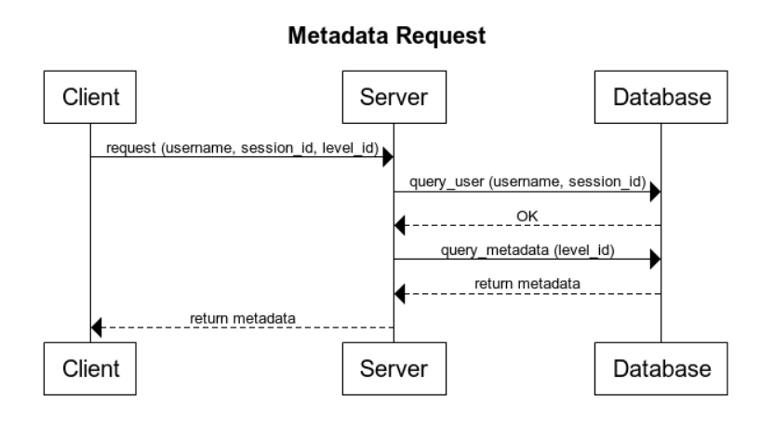
Implementations Level Generation
Level generation requires metadata.
Fetched from the server (POST).
Figure 16. Metadata request sequence diagram
Hierarchical parsing and passing of component metadata.
Figure 17. Flowchart of level generation process

Slide 18
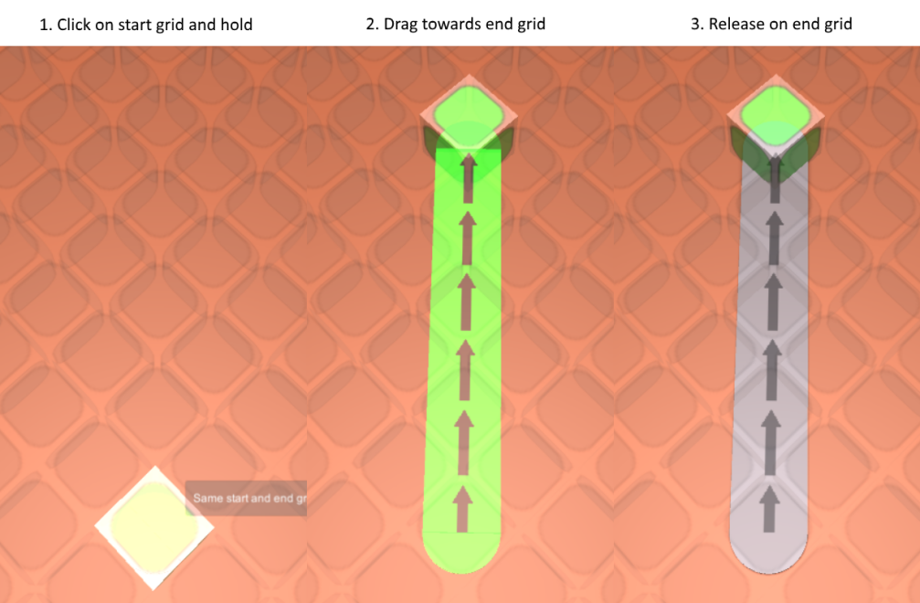
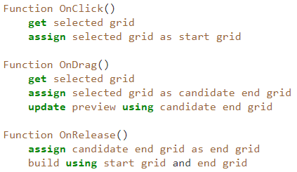
Implementations Click, Hold and Drag Building Mechanism
The user actions required to build structures (roads and buildings) are as follows:
Click on start grid and hold the mouse button.
Drag the cursor towards the designated end grid.
Release the mouse button to confirm building process.
Figure 19. Click, hold and drag mechanism in-game
Figure 18. Pseudocode of click, hold and drag mechanism

Slide 19
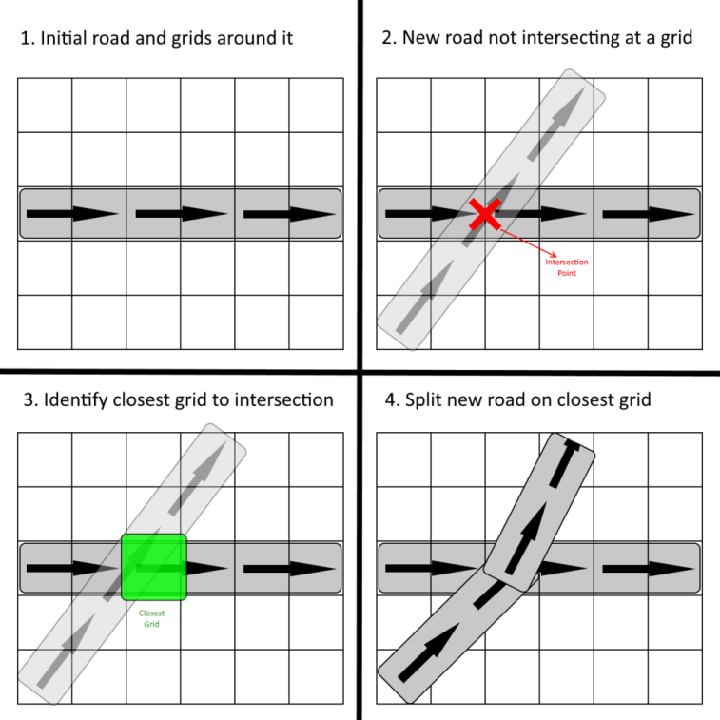
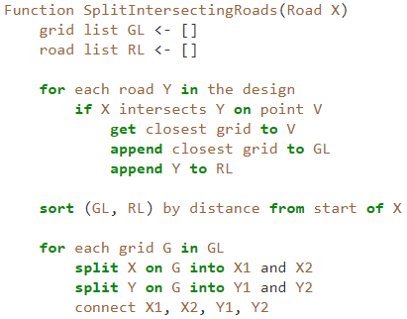
Implementations Splitting of Roads on Intersections
Whenever a user built a new road, the new road could intersect an existing road.
The roads would be split at the intersection point,
And the resulting roads rejoined.
Figure 21. Illustration of road splitting mechanism
Figure 20. Pseudocode of road splitting mechanism

Slide 20
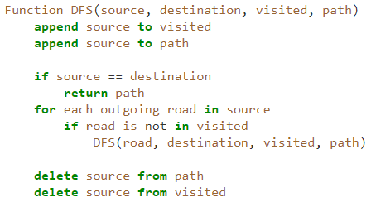
Implementations Path Generation for Simulation Purposes
Before traffic simulation, all possible paths would need to be generated for vehicle path-following purposes.
This is done by performing DFS on each entry-exit points pair, recording all possible paths between them.
Figure 22. Pseudocode of path-generation using DFS

Slide 21
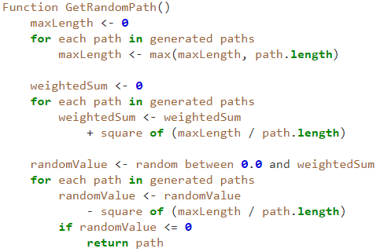
Implementations Vehicle Path-selection Behavior
A vehicle needs to select a path from its source towards its destination.
Selection is done in a weighted random fashion, with longer paths having significantly lower chances to get selected.
weight = (max_path_length / path_length)²
Figure 23. Pseudocode of weighted random path-selection

Slide 22
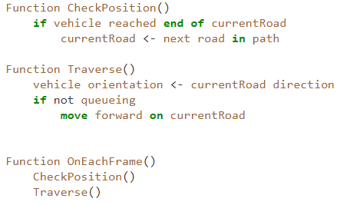
Implementations Vehicle Path-following Behavior
After selecting a path, the vehicle needs to be able to follow the path towards its destination.
This is done by checking the vehicle position on each frame, updating the currently traversed road whenever it reaches the end of the current road.
Figure 24. Pseudocode of path-following behavior

Slide 23
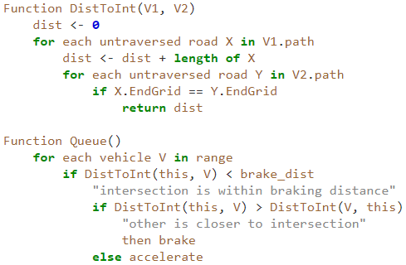
Implementations Vehicle Queuing Behavior
The vehicle queuing algorithm could be described as follows:
Each frame, retrieve all vehicles (S) within queueing range of this vehicle V1.
For each vehicle V2 in S, calculate the future intersection point between V1 and V2 and the distance to it (D1 and D2).
If D1 > D2 (this vehicle is further to the intersection), then stop and let the other vehicle go through.
Figure 25. Pseudocode of vehicle queuing behavior

Slide 24
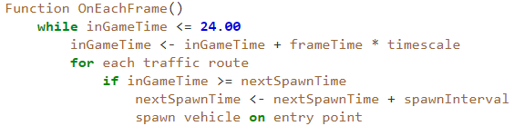
Implementations Simulation Loop
Simulation is controlled by SimulationManager class.
Simulation time is continuously updated.
Vehicles are spawned accordingly.
Figure 26. Pseudocode of simulation loop

Slide 25
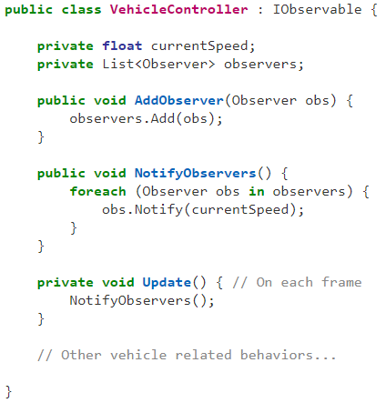
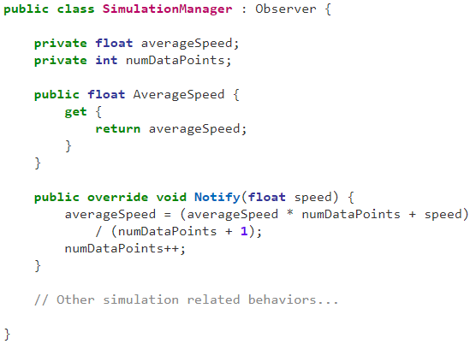
Implementations Simulation Loop
SimulationManager needs to keep track of the average traffic speed.
For design efficiency measure (simulation score) purposes.
Observer pattern.
Figure 27. C# snippets of observer and
observable in measuring traffic speed

Slide 26
Recap
A Typical User Experience

Slide 27
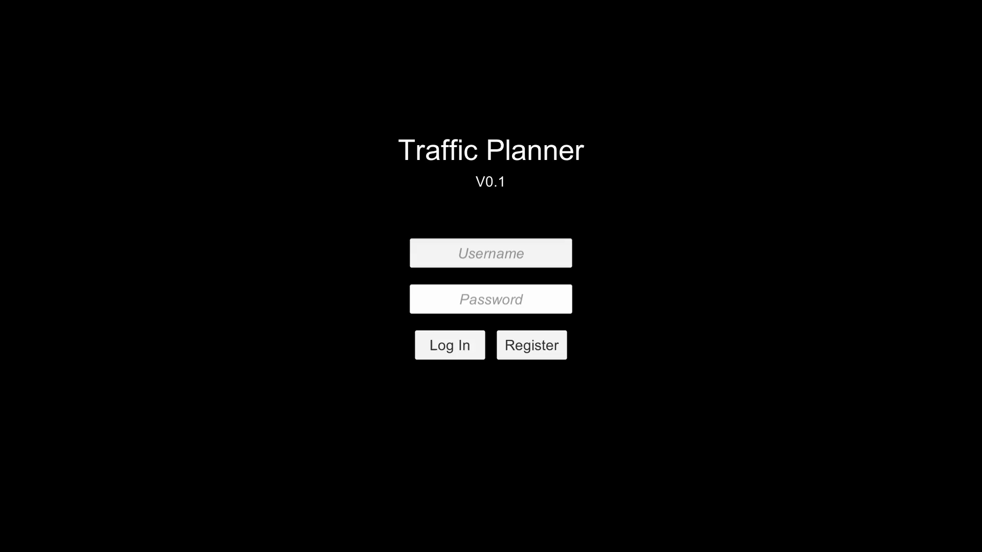

Slide 28
Evaluations
Determinism of Simulation and Overall User Experience

Slide 29
Determinism of Simulation
Simulation needs to be consistent.
The simulation score is used to gauge the efficiency of one's design.
The same design could be reproduced and simulated on different environments.
Method:
Run simulations on a sufficiently complex road network on 2 different environments.
Gather the simulation scores on both environments.
Calculate the average and standard deviation of scores within a single environment.
Prove the statistical significance/insignificance of the score differences using the standard deviation.

Slide 30
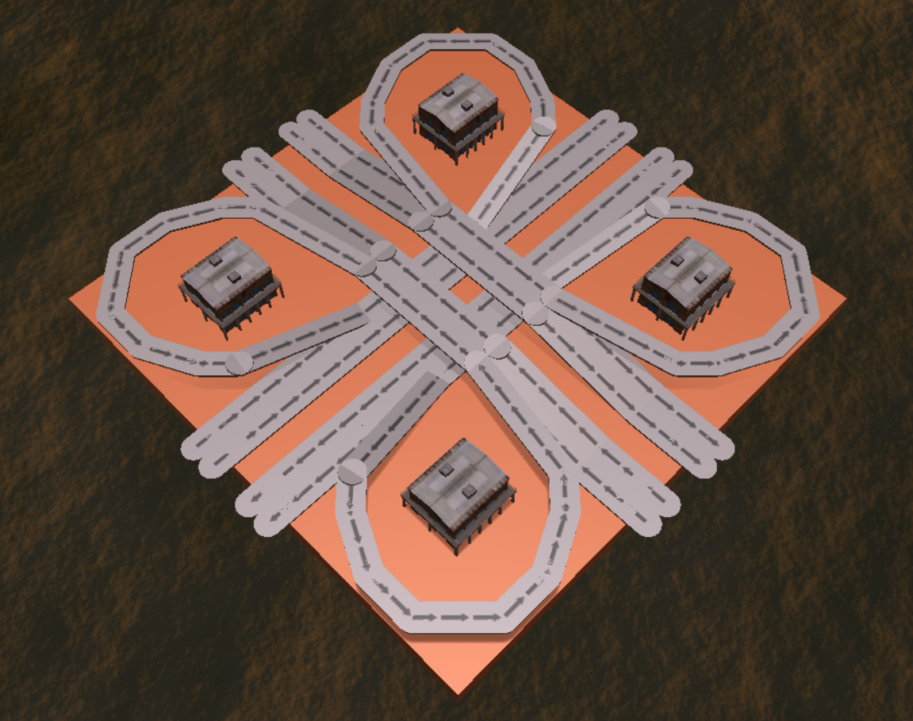
Determinism of Simulation
Run simulations on a sufficiently complex road networks on 2 different computing environments.
The selected road network features a lot of intersections.
Figure 28. Road network used for evaluation

Slide 31
Determinism of Simulation
Gather simulation scores on both environments.
Environment 1 | Environment 2
0.002382 | 0.002380
0.002386 | 0.002374
0.002382 | 0.002379
0.002391 | 0.002378
0.002386 | 0.002375
0.002382 | 0.002374
0.002386 | 0.002351
0.002376 | 0.002367
0.002356 | 0.002381
0.002380 | 0.002378
 | Environment 1 | Environment 2
OS | Windows 10 | Windows 10
Processor | Intel i7-7700HQ Quad Core @2.8 Ghz | Intel i7-4510U Quad Core @2.0 Ghz
Graphics Card | NVIDIA GeForce GTX1060 | AMD Radeon R7 M265
RAM | 16 GB | 8 GB
Table 1. System specifications of the two environments
Table 2. Simulation results on the two environments

Slide 32
Determinism of Simulation
Calculate the average and standard deviation of scores on both environments.
 | Environment 1 | Environment 2
Average | 2.381 x 10⁻³ | 2.374 x 10⁻³
Std. Dev. | 9 x 10⁻⁶ | 8 x 10⁻⁶
Table 3. Average and standard deviations of simulation scores

Slide 33
Determinism of Simulation
Prove the statistical insignificance of the score difference.
Average difference < 2 standard deviations
Figure 29. Statistical insignificance of score difference

Slide 34
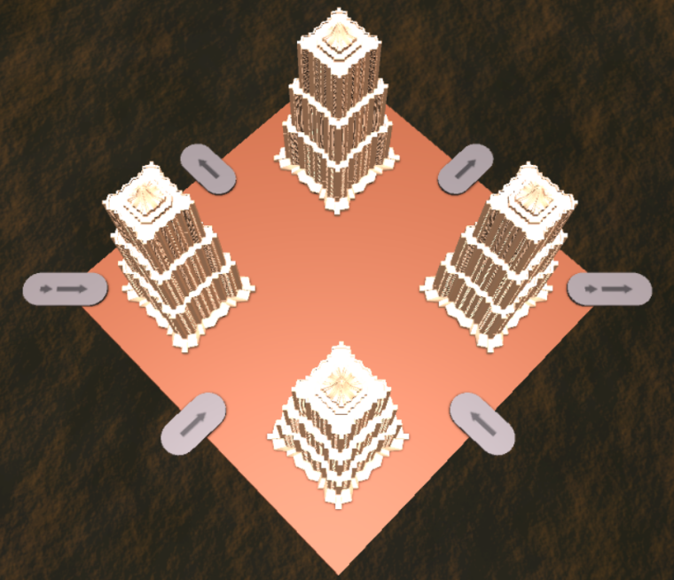
Overall User Experience
Users were asked to try the challenge level multiple times and try to get the highest score possible.
They were asked to fill in a survey afterwards.
Their attempts were recorded.
Figure 30. Challenge level used in the group test

Slide 35
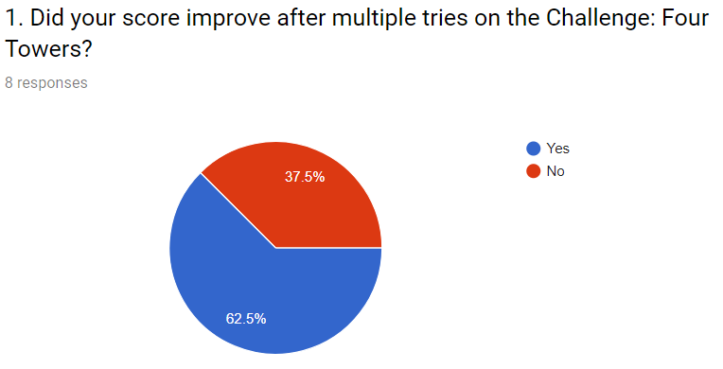
Overall User Experience
Most users managed to improve their scores after multiple tries.
An indication of learning.
Figure 31. Score improvements in challenge level

Slide 36
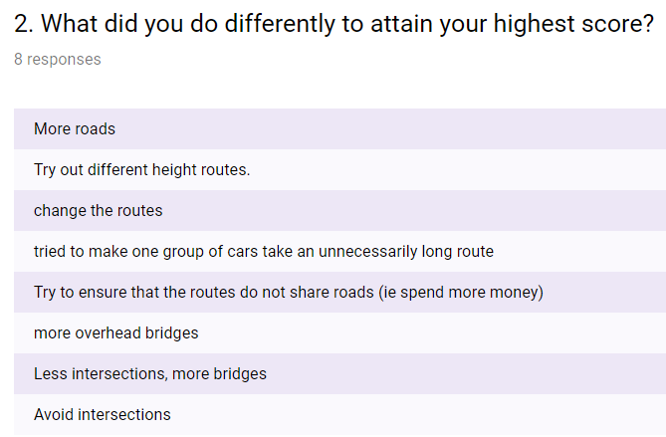
Overall User Experience
Some key principles in road design has been successfully identified by the users.
Again, indication of learning.
Also shows that the simulation score is sufficient in indicating that a design could still be improved.
Figure 32. Approaches to attaining the highest score

Slide 37
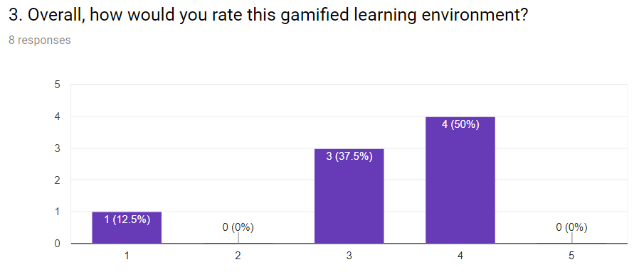
Overall User Experience
3.25 / 5 average score.
Some feedbacks:
Introduce more road types
Overall better UI design
Guidelines to road design
Figure 33. Ratings given to TrafficPlanner as a
learning environment

Slide 38
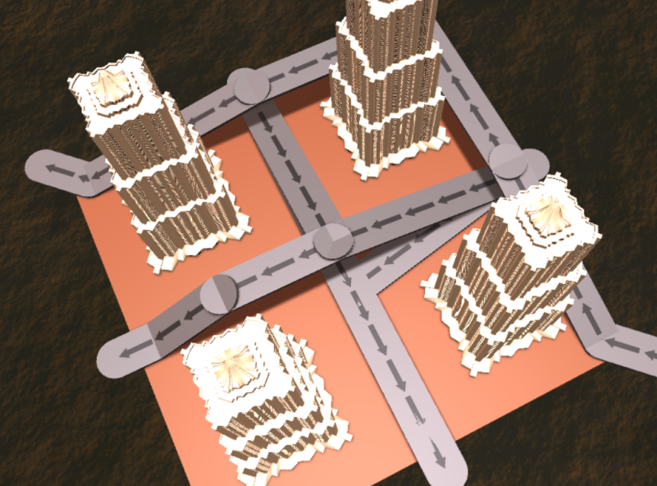
A Closer Look at a Participant's Attempt
Figure 34. Challenge level used in the group test
Figure 35. User “123”'s attempt at the challenge level

Slide 39
Conclusion and Future Work
A recap of the things discussed and recommendations for future contributors

Slide 40
Conclusion
The major design decisions and implementations of TrafficPlanner have been discussed throughout this presentation. TrafficPlanner has been demonstrated to be effective at being a gamified platform that involves and educates members of the general public in traffic planning.

Slide 41
Recommendations for Future Work
Implementation of multi-lane roads.
Implementation of traffic lights and other traffic signals.
Traffic deadlocks.
Undervaluation of intersections.
User interface refinements.
Overall color scheme.
Less text feedbacks.

Slide 42
Thank You
http://www.github.com/AlvianPrasetya/TrafficPlanner
http://AlvianPrasetya.com/TrafficPlanner

